Slide 1
Chapter 3 & 9
The Relational Data Model and Relational Database Constraints
&
Relational Database Design by ER- and EER-to-Relational Mapping

Slide 2
Chapter 3 & 9 Outline
The Relational Data Model and
Relational Database Constraints
Relational Model Constraints
and Relational Database Schemas
Relational Database Design Using ER-to-Relational Mapping
Mapping EER Model Constructs to Relations

Slide 3
The Relational Data Model and
Relational Database Constraints
Relational model
  The relational data model was first introduced by Ted Codd of IBM Research in 1970 in a classic paper (Codd,1970)
  First commercial implementations available in early 1980s
  Has been implemented in a large number of commercial system such as the SQL/DS system on the MVS operating system by IBM and the Oracle DBMS

Slide 4
The Relational Data Model and
Relational Database Constraints, Cont’d…
Relational model
  Since then, the model has been implemented in a large number of commercial systems, as well as a number of open source systems. Current
  popular commercial relational DBMSs (RDBMSs) include DB2 (from IBM), Oracle from Oracle), Sybase DBMS (now from SAP), and SQLServer and Microsoft Access (from Microsoft).
  In addition, several open source systems, such as MySQL and PostgreSQL, are available.
Hierarchical and network models
  Preceded the relational model

Slide 5
Relational Model Concepts
Represents data as a collection of relations
Table of values
  Row
    Represents a collection of related data values
    Fact that typically corresponds to a real-world entity or relationship
    Tuple
  Table name and column names
    Interpret the meaning of the values in each row attribute

Slide 6
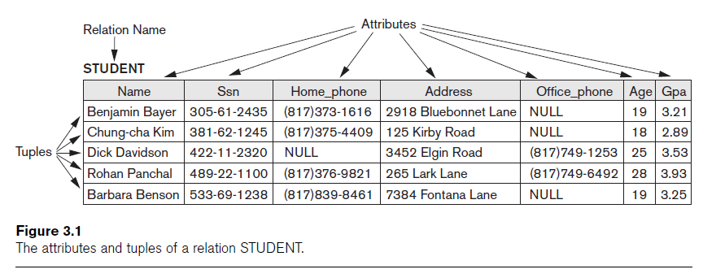
Relational Model Concepts (cont’d.)

Slide 7
Domains, Attributes, Tuples, and Relations
Domain D
  Set of atomic values
Atomic
  Each value indivisible
Specifying a domain
  Data type specified for each domain

Slide 8
Domains, Attributes, Tuples, and Relations (cont’d.)
Relation schema R
  Denoted by R(A₁, A₂, ...,A_{n})
  Made up of a relation name R and a list of attributes, A₁, A₂, ..., A_{n}
Attribute A_{i}
  Name of a role played by some domain D in the relation schema R
Degree (or arity) of a relation
  Number of attributes n of its relation schema

Slide 9
Domains, Attributes, Tuples, and Relations (cont’d.)
Relation (or relation state)
  Set of n-tuples r = {t₁, t₂, ..., t_{m}}
  Each n-tuple t
    Ordered list of n values t =<v₁, v₂, ..., v_{n}
    Each value v_{i}, 1 ≤ i ≤ n, is an element of dom(A_{i}) or is a special NULL value

Slide 10
Domains, Attributes, Tuples, and Relations (cont’d.)
Cardinality
  Total number of values in domain
Current relation state
  Relation state at a given time
  Reflects only the valid tuples that represent a particular state of the real world
Attribute names
  Indicate different roles, or interpretations, for the domain

Slide 11
Characteristics of Relations
Ordering of tuples in a relation
  Relation defined as a set of tuples
  Elements have no order among them
Ordering of values within a tuple and an alternative definition of a relation
  Order of attributes and values is not that important
  As long as correspondence between attributes and values maintained

Slide 12
Characteristics of Relations (cont’d.)
Values and NULLs in tuples
  Each value in a tuple is atomic
  Flat relational model
    Composite and multivalued attributes not allowed
    First normal form assumption
  Multivalued attributes
    Must be represented by separate relations
  Composite attributes
    Represented only by simple component attributes in basic relational model

Slide 13
Characteristics of Relations (cont’d.)
NULL values
  Represent the values of attributes that may be unknown or may not apply to a tuple
  Meanings for NULL values
    Value unknown
    Value exists but is not available
    Attribute does not apply to this tuple (also known as value undefined)

Slide 14
Characteristics of Relations (cont’d.)
Interpretation (meaning) of a relation
  Assertion
    Each tuple in the relation is a fact or a particular instance of the assertion
  Predicate
    Values in each tuple interpreted as values that satisfy predicate

Slide 15
Relational Model Constraints
Constraints
  Restrictions on the actual values in a database state
  Derived from the rules in the miniworld that the database represents
Inherent model-based constraints or implicit constraints
  Inherent in the data model

Slide 16
Relational Model Constraints (cont’d.)
Schema-based constraints or explicit constraints
  Can be directly expressed in schemas of the data model
Application-based or semantic constraints or business rules
  Cannot be directly expressed in schemas
  Expressed and enforced by application program

Slide 17
Domain Constraints
Typically include:
  Numeric data types for integers and real numbers
  Characters
  Booleans
  Fixed-length strings
  Variable-length strings
  Date, time, timestamp
  Money
  Other special data types

Slide 18
Key Constraints and Constraints on NULL Values
No two tuples can have the same combination of values for all their attributes.
Superkey
  No two distinct tuples in any state r of R can have the same value for SK
Key
  Superkey of R
  Removing any attribute A from K leaves a set of attributes K that is not a superkey of R any more

Slide 19
Key Constraints and Constraints on NULL Values (cont’d.)
Key satisfies two properties:
  Two distinct tuples in any state of relation cannot have identical values for (all) attributes in key
  Minimal superkey
    Cannot remove any attributes and still have uniqueness constraint in above condition hold

Slide 20
Key Constraints and Constraints on NULL Values (cont’d.)
Candidate key
  Relation schema may have more than one key
Primary key of the relation
  Designated among candidate keys
  Underline attribute
Other candidate keys are designated as unique keys

Slide 21
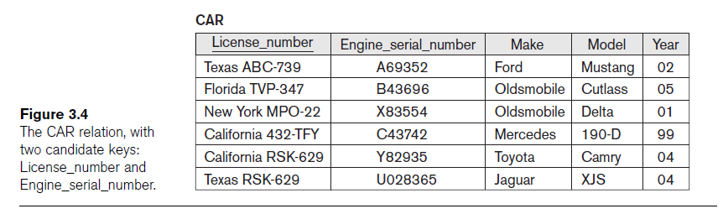
Key Constraints and Constraints on NULL Values (cont’d.)

Slide 22
Integrity, Referential Integrity, and Foreign Keys
Entity integrity constraint
  No primary key value can be NULL
Referential integrity constraint
  Specified between two relations
  Maintains consistency among tuples in two relations

Slide 23
Integrity, Referential Integrity, and Foreign Keys (cont’d.)
Foreign key rules:
  The attributes in FK have the same domain(s) as the primary key attributes PK
  Value of FK in a tuple t₁ of the current state r₁(R₁) either occurs as a value of PK for some tuple t₂ in the current state r₂(R₂) or is NULL

Slide 24
Integrity, Referential Integrity, and Foreign Keys (cont’d.)
Diagrammatically display referential integrity constraints
  Directed arc from each foreign key to the relation it references
All integrity constraints should be specified on relational database schema

Slide 25
Relational Database
Design by ER- and EER-to-Relational Mapping
Design a relational database schema
  Based on a conceptual schema design
Seven-step algorithm to convert the basic ER model constructs into relations
Additional steps for EER model

Slide 26
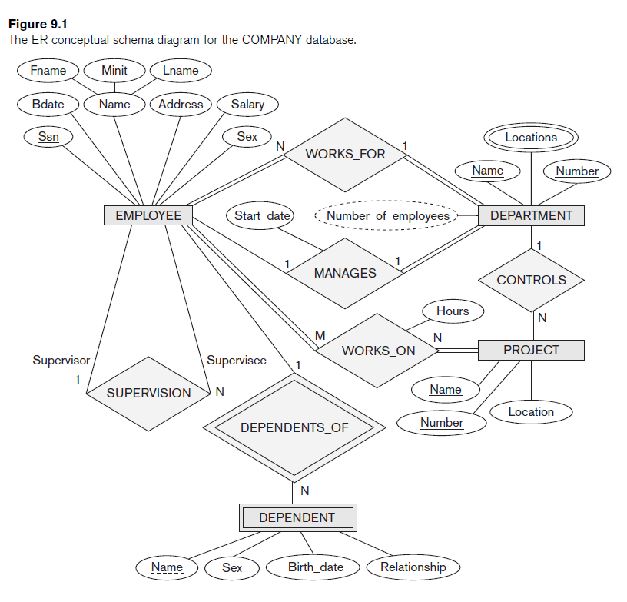
Relational Database Design Using ER-to-Relational Mapping

Slide 27
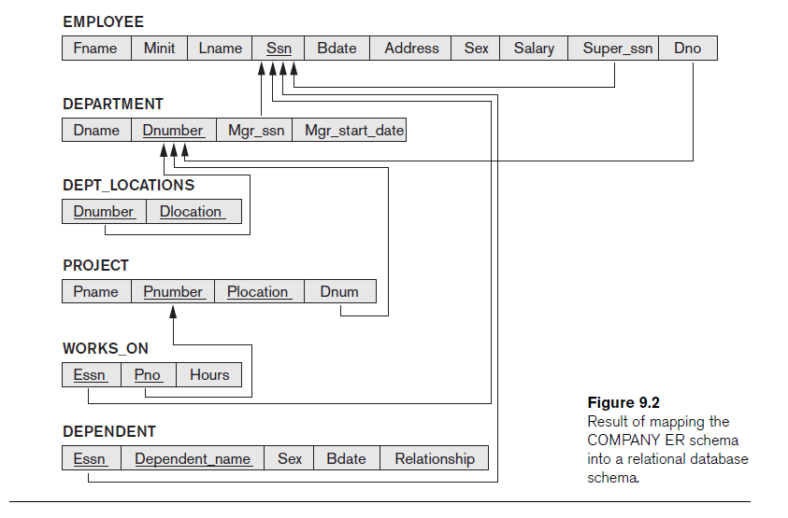

Slide 28
ER-to-Relational Mapping Algorithm
COMPANY database example
  Assume that the mapping will create tables with simple single-valued attributes
Step 1: Mapping of Regular Entity Types
  For each regular entity type, create a relation R that includes all the simple attributes of E
  Called entity relations
    Each tuple represents an entity instance

Slide 29
ER-to-Relational Mapping Algorithm (cont’d.)
Step 2: Mapping of Weak Entity Types
  For each weak entity type, create a relation R and include all simple attributes of the entity type as attributes of R
  Include primary key attribute of owner as foreign key attributes of R

Slide 30
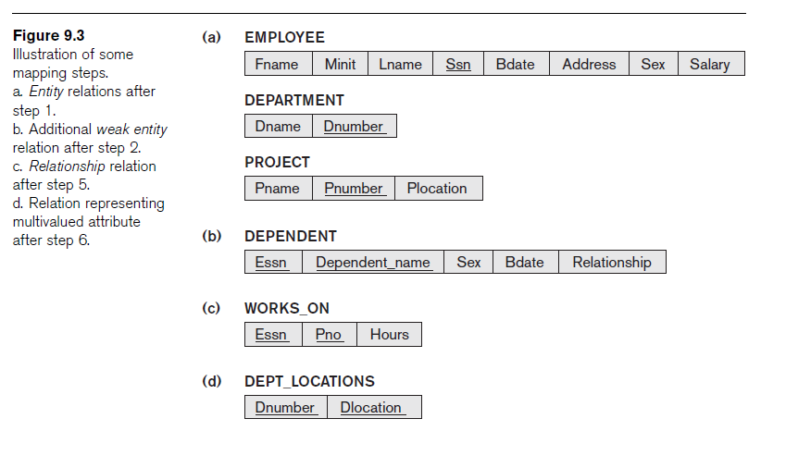
ER-to-Relational Mapping Algorithm (cont’d.)

Slide 31
ER-to-Relational Mapping Algorithm (cont’d.)
Step 3: Mapping of Binary 1:1 Relationship Types
  For each binary 1:1 relationship type
    Identify relations that correspond to entity types participating in R
  Possible approaches:
    Foreign key approach
    Merged relationship approach
    Crossreference or relationship relation approach

Slide 32
ER-to-Relational Mapping Algorithm (cont’d.)
Step 4: Mapping of Binary 1:N Relationship Types
  For each regular binary 1:N relationship type
    Identify relation that represents participating entity type at N-side of relationship type
    Include primary key of other entity type as foreign key in S
    Include simple attributes of 1:N relationship type as attributes of S

Slide 33
ER-to-Relational Mapping Algorithm (cont’d.)
  Alternative approach
    Use the relationship relation (cross-reference) option as in the third option for binary 1:1 relationships

Slide 34
ER-to-Relational Mapping Algorithm (cont’d.)
Step 5: Mapping of Binary M:N Relationship Types
  For each binary M:N relationship type
    Create a new relation S
    Include primary key of participating entity types as foreign key attributes in S
    Include any simple attributes of M:N relationship type

Slide 35
ER-to-Relational Mapping Algorithm (cont’d.)
Step 6: Mapping of Multivalued Attributes
  For each multivalued attribute
    Create a new relation
    Primary key of R is the combination of A and K
    If the multivalued attribute is composite, include its simple components

Slide 36
ER-to-Relational Mapping Algorithm (cont’d.)
Step 7: Mapping of N-ary Relationship Types
  For each n-ary relationship type R
    Create a new relation S to represent R
    Include primary keys of participating entity types as foreign keys
    Include any simple attributes as attributes

Slide 37
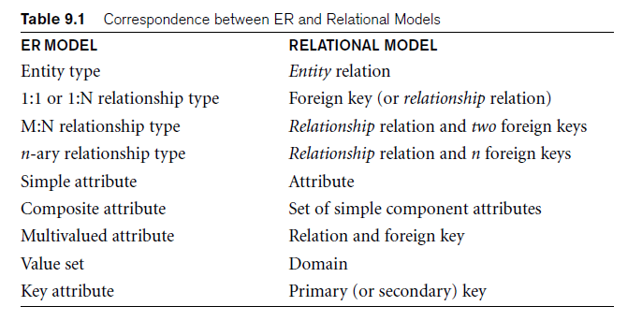
Discussion and Summary of Mapping for ER Model Constructs

Slide 38
Discussion and Summary of Mapping for ER Model Constructs (cont’d.)
In a relational schema relationship, types are not represented explicitly
  Represented by having two attributes A and B: one a primary key and the other a foreign key

Slide 39
Mapping EER Model Constructs to Relations
Extending ER-to-relational mapping algorithm

Slide 40
Mapping of Specialization or Generalization
Step 8: Options for Mapping Specialization or Generalization (see pages 294-295)
  Option 8A: Multiple relations—superclass and subclasses
    For any specialization (total or partial, disjoint or overlapping)
  Option 8B: Multiple relations—subclass relations only
    Subclasses are total
    Specialization has disjointedness constraint

Slide 41
Mapping of Specialization or Generalization (cont’d.)
  Option 8C: Single relation with one type attribute
    Type or discriminating attribute indicates subclass of tuple
    Subclasses are disjoint
      Potential for generating many NULL values if many specific attributes exist in the subclasses
  Option 8D: Single relation with multiple type attributes
    Subclasses are overlapping
    Will also work for a disjoint specialization

Slide 42
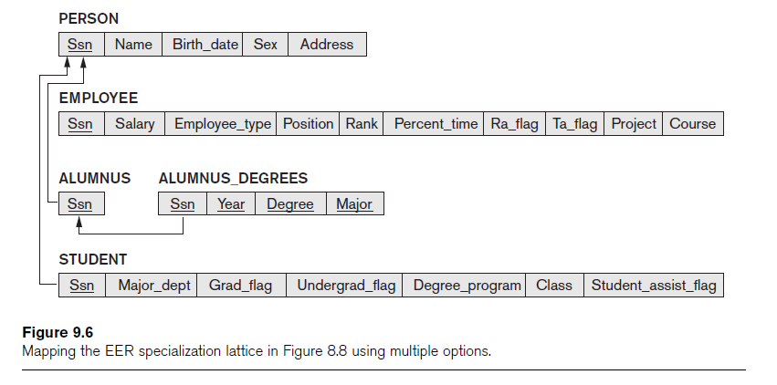
Mapping of Shared Subclasses (Multiple Inheritance)
Apply any of the options discussed in step 8 to a shared subclass

Slide 43
Mapping of Categories (Union Types)
Step 9: Mapping of Union Types (Categories)
  Defining superclasses have different keys
  Specify a new key attribute
    Surrogate key

Slide 44
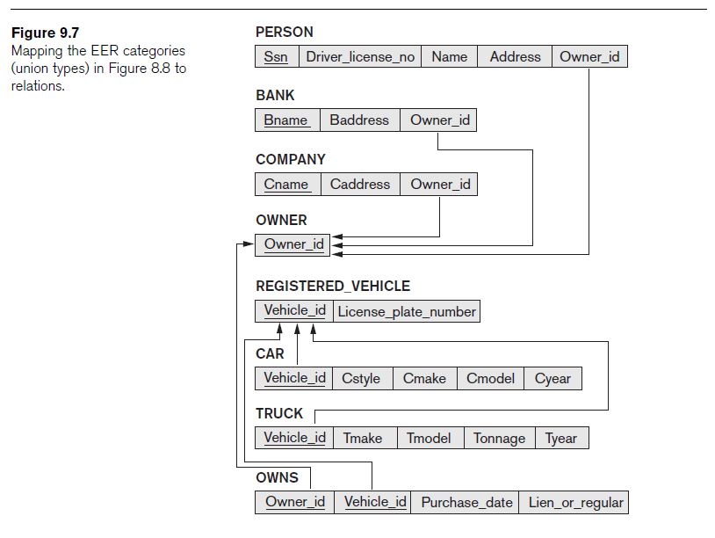
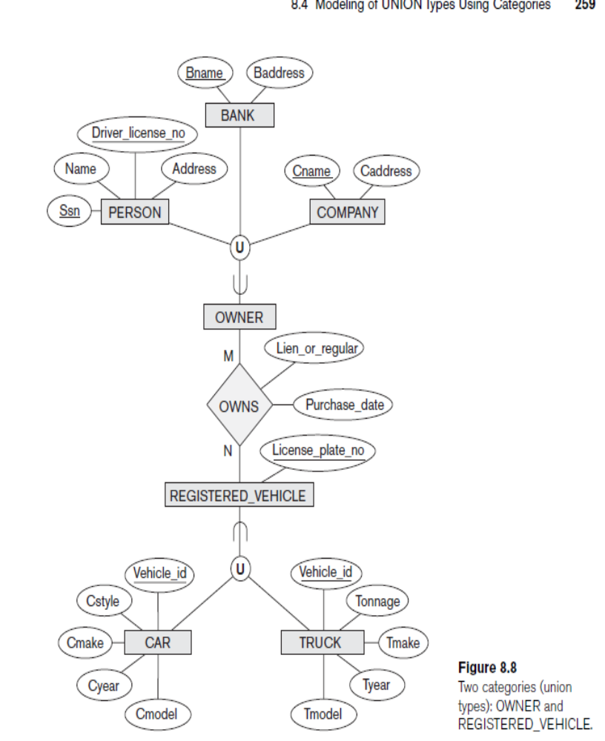

Slide 45
Summary
Characteristics differentiate relations from ordinary tables or files
Classify database constraints into:
  Inherent model-based constraints, explicit schema-based constraints, and application-based constraints

Slide 46
Summary
Map conceptual schema design in the ER model to a relational database schema
  Algorithm for ER-to-relational mapping
  Illustrated by examples from the COMPANY database
Include additional steps in the algorithm for mapping constructs from EER model into relational model

